Slide 1
Motor neurone disease

Slide 2
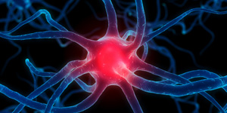
What is motor neurone disease?
Motor Neurone Disease (MND) is an uncommon disease that affects the brain and nerves
In MND your motor nerves become damaged and eventually stop working and you gradually lose your strength
There is currently no cure for Motor Neurone Disease

Slide 3
Who gets it and why?
Motor Neurone Disease is an uncommon disease that can affect adults and children
Although it is uncommon it can affect anyone at any time
2 people in everyone 100,000 will develop Motor Neurone Disease each year

Slide 4
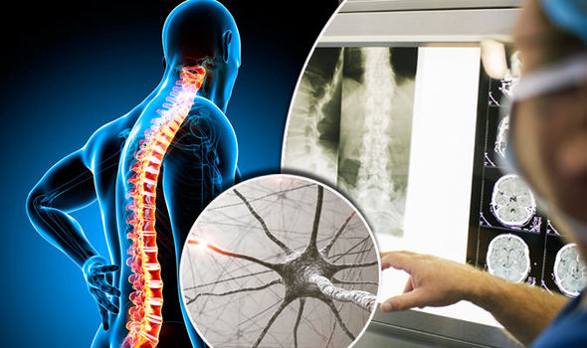
What happens to your body?
The physical effects of Motor Neuron Disease include:
Muscle aches, cramps and twitching
Weakness in arms and legs
Slurred speech, difficulty swallowing and chewing
50% of people with MND can experience changes in personality, behaviour, and language

Slide 5
Who can help?
The Irish Motor Neuron Disease Association (IMNDA) is the only organisation in Ireland that provides support and care to people living with MND and their families
They provide care services, financial support and promote research into the causes and treatments of MND
All the money the IMNDA raises comes from fundraisers throughout the country

Slide 6
Get involved!
Presentation College Headford will be hosting a colour run in aid of the IMNDA
It will be held on April 12th at 2pm with the entry fee of €5

