Slide 1
What is Junior Cycle?
John Toner, PCH
November 2019

Slide 2
Overview
Why Junior Cycle? (And why this talk?!)
What is Junior Cycle and where did it come from?
Changes in assessment and reporting
Class-Based Assessments (CBAs)
New grading descriptors
Junior Cycle Profile of Achievement (JCPA)

Slide 3
Alert!

Slide 4
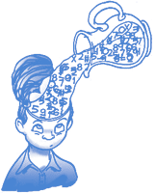
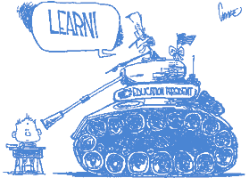
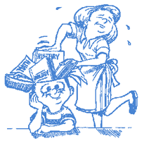
Context
Our view of education/school may be skewed by our own experiences…

Slide 5
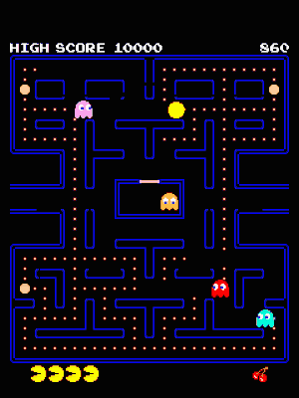
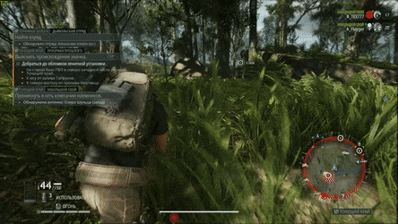
Context
Education in Ireland has changed/is changing
Change is happening rapidly

Slide 6
Junior Cycle - Framework
New framework: 8 principles
Principle | Description
Learning to learn | Curriculum, assessment → more independence in learning
Choice and flexibility | Broad choice of subjects and learning opportunities
Quality | High expectations of all learners
Creativity and innovation | Provide opportunities for more creativity and innovation
Engagement and participation | Encourage participation, generate engagement, enthusiasm
Continuity and development | Build on previous learning and recognise their progress
Inclusive education | Inclusion, equality of opportunity, outcomes for all
Wellbeing | Physical, mental, emotional, social wellbeing and resilience. Collective wellbeing → school, community, society

Slide 7
Statements of Learning
24 statements that outline what all students “have access to” throughout their 3 years in Junior Cycle

Slide 8
Key Skills
8 key high-level skills that pervade the 3-year Junior Cycle programme

Slide 9
Subject Specifications
2014
2016
2017
2018
2019

Slide 10
Wellbeing
Wellbeing is one of the core principles of the Junior Cycle
Within PCH:
PE, CSPE, SPHE, and dedicated Wellbeing classes
Management positions created in the past year solely for student wellbeing

Slide 11
Level 2 Learning Programmes (L2LPs)
Targeted at those with special educational needs who can’t access Junior Cycle
Awards at Level 2 on NFQ (JC is Level 3)
Typically, only small numbers of students in a typical school (< 5 students)
Programme is built in school to match students ability and needs
Also a L1LP but may not apply to mainstream schools

Slide 12
New Assessment and Reporting
Assessment should be a more formative focus
Student focussed
More variety in assessment methods
Not just written exams
Teachers work collaboratively
SLARs etc

Slide 13
What’s a CBA?
Class-Based Assessment
Work done, mainly in class, which assesses some relevant skill/skills within the subject area
2 in each subject (2nd/3rd yr)
Assessment task in 3rd yr
Normally 3 weeks duration
Provisionally graded by own teacher
Confirmed after SLAR

Slide 14
CBA Reporting
4 descriptors:
Yet to meet expectations
In line with expectations
Above expectations
Exceptional
Based on a set of features of quality that are given to the students before the CBA begins
Subject Learning and Assessment Review
By definition, most students will be here!!!

Slide 15
SLAR
Teachers meet to discuss their class’s work
Examples of work at each grade descriptor are brought by each teacher
One teacher facilitates the meeting
Pieces of work are reviewed and assessed by all teachers at the SLAR
This helps to ensure a “level playing field”
Features of Quality are a national standard

Slide 16
Assessment Task
Completed after the 3rd year CBA
Done during class time (40 mins)
3-page SEC booklet with questions on individual student’s own CBA experience
Parts are reflective
Marked externally by the SEC, in the same way as the written exams are

Slide 17
State-Certified Exams
Held at the end of 3rd year, as usual
Core subjects have higher and ordinary levels
English, Irish, Maths
All other subjects examined at common level
2 hour exams
Also new grading descriptors for this
No more A, B, C, D, E, F, NG

Slide 18
Grade Descriptors
Broad!!
Difficult to map this onto the old grading system for comparison
Different from the LC grading system

Slide 19
Junior Cycle Profile of Achievement
Reports on:
SEC exam results
Results in Class-Based Assessments
Other Areas of Learning
Students mention learning experiences they have had outside of the classroom setting
Extracurricular activities, sports, community involvement etc.

Slide 20
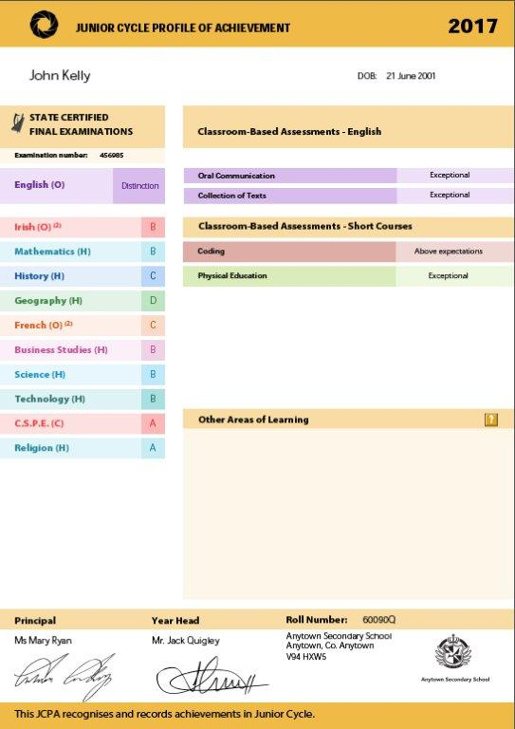
JCPA Sample

Slide 21
Thank you!
Questions?

Slide 22
Websites
https://www.ncca.ie/en/junior-cycle
https://www.jct.ie/
https://www.schooldays.ie/articles/guide-to-the-new-junior-cycle
https://www.curriculumonline.ie/Junior-cycle

