Slide 1
Junior Certificate School Programme (JCSP)
FAQs

Slide 2
What is JCSP?
The Junior Certificate School Programme (JCSP) is an intervention into the Junior Certificate/Cycle and not an alternative to it. It helps to make the curriculum accessible and relevant to young people who would benefit from a different approach to the Junior Certificate/Junior Cycle.
The attempts to help young people experience success and develop a positive self-image by providing a curriculum and assessment framework suitable to their needs.
The programme aims to ensure that students actively participate in their learning, make progress and build on their achievements. The programme also aims to develop students’ literacy, numeracy, communication and group work skills.
On completion of the programme, students receive an profile which is an official record of their achievements. They will receive this profile in addition to their Junior Cycle Profile of Achievement, which outlines their Junior Certificate results and their CBA descriptors.
JCSP has been described as the Junior Certificate/Cycle with the added bonus of extra continuous support to promote success.

Slide 3
Is JCSP an alternative to Junior Certificate?
Do JCSP students sit the Junior Certificate exam?
No, the Junior Certificate School Programme is not an alternative to the Junior Certificate. It is a framework that is designed to help schools and teachers develop an imaginative approach to the Junior Certificate.
All the students in the Programme must be entered for the Junior Certificate examination.
Absolutely! The whole point of participating in the Junior Certificate School Programme is to stay at school, experience success in school and become more confident about sitting the Junior Certificate Exam.
Having participated in the JCSP may mean that students have experienced a deeper engagement with the learning at Junior Cycle.

Slide 4
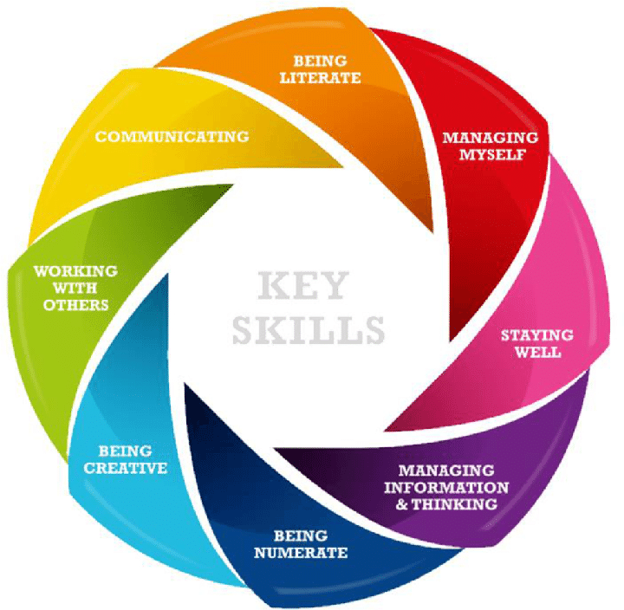
What is the difference between Junior Certificate/Junior Cycle and JCSP?
The Junior Certificate School Programme is means for working towards acquiring the skills assessed in the Junior Certificate/Junior Cycle. Students will work with their teachers in their regular time-tabled classes to achieve specific progress goals and targets that keep them on track with their learning.
The JCSP subject statements that students complete in this programme are linked with the key skills in the Junior Cycle programme. JCSP is designed to work in tandem with the Junior Cycle curriculum and reinforces content and skills in all subject areas.

Slide 5
Who benefits from participating in JCSP?
There are many reasons a student might be invited to take part in JCSP:
Students may have a history or absenteeism in primary school
Students may wish to improve their literacy skills
Students may wish to improve their numeracy skills
Students may benefit from additional progress checks with their teachers to keep their learning on track

Slide 6
What do students gain from participating
in JCSP?
Students are provided the opportunity to become owners of their own learning by discussing statements and meeting agreed targets with their teachers at various points throughout the school year. This promotes positive, open communication between teachers and students.
Throughout their time on the Programme, the JCSP team seeks out opportunities to reward and praise students and to give them useful feedback on their performance.
Students also have the opportunity to participate in fun initiatives to support their learning. Often these initiatives are run in the context of form groups, but JCSP students will be specifically rewarded for their participation in their final profiling certificate from the Department of Education at the end of year 3.
The Programme is designed to ensure that students can benefit from their time in school and enjoy the experience of improvement and success.
JCSP also allows for students to be rewarded for their participation in extracurricular activities and for their effort in improving attendance.
The objective of the programme is to ensure that ‘every student is capable of success’.

Slide 7
Where do I get further information
about JCSP?
Visit the JCSP website www.jcsp.ie or contact the Programme Coordinator, Sinéad Conlon via email (sinead.conlon@presheadford.ie).

